Slide 1
Application development

Slide 2
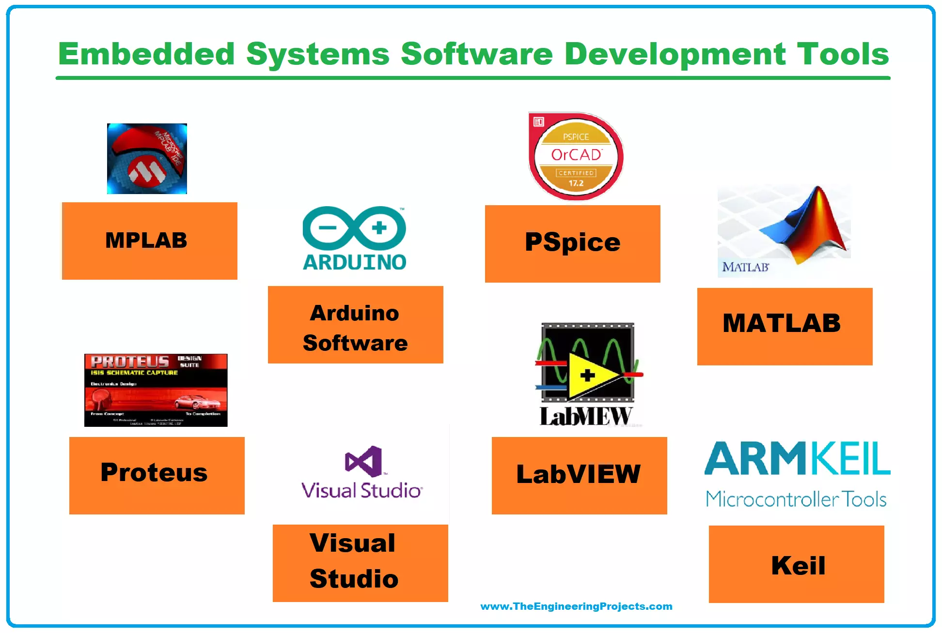

Slide 3
Application development and testing

Slide 4
Testing the Application
DEBUGGING

Slide 5
Breakpoints and Watch points
. Breakpoints
Breakpoints are extremely valuable for inspecting the processor state at any point in time.
The processor is prevented from moving onto the next instruction once it hits a breakpoint.
Watch points
A watchpoint is similar to a breakpoint, but it is the address of a data access that is monitored rather than an instruction being executed.
Watch points are used to create a breakpoint in the processor when a specific value of a variable or expression changes. This could happen at any point during the program.
When using breakpoints or watch points , if the system is receiving data or information from a external source , the processor is paused during that time , it is likely that data will be missed .
This is because the normal operation of the microcontroller is likely handling the incoming event.

Slide 6
Debugger
A Debugger or debugging tool is a computer program that is used to test and debug other programs. ..

Slide 7

DEBUGGING THE EMBEDDED SOFTWARE Challenges in Microcontroller env..
Debugging is the process of eliminating the bugs/errors in software.
However, the difficulty in case of embedded systems is to find out the bug/ error itself.
Input values are totally dependent of real world events or time
This often reveals unexpected operation when an input goes to full scale

Slide 8
DEBUGGING THE EMBEDDED SOFTWARE Challenges in Microcontroller env..
In microcontrollers, the contents of any RAM locations/variables are totally invisible during program execution
The lack of real time inspection inevitably alters the interaction between interrupt and background routines so that critical regions may never be found.
Static analysis of real time systems or dynamic testing ???

Slide 9
Requirements for Debugging
There are three requirements for debugging an embedded or real-time system.
Memory substitution : Memory substitution is replacing ROM-based memory with RAM for rapid and easy code download, debug, and repair cycles
Run control : ability to start, stop, peek the processor and memory
Real time analysis: Following code flow in real time with real-time trace analysis

Slide 10
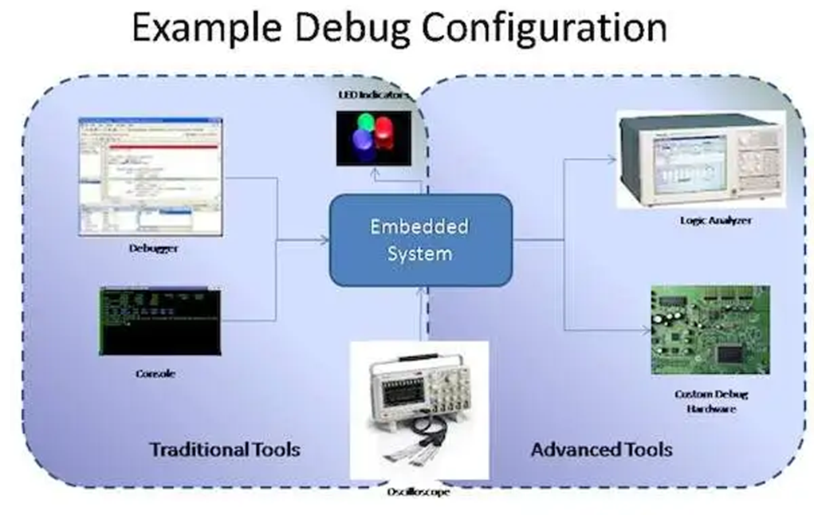
Debugger in embedded system
A low-level debugger or a machine-language debugger shows the corresponding line in the program.
Similar to debugging a host based application
Catching run-time errors is complex since most embedded systems do not have a “screen”
For embedded systems, we typically have supporting hardware that helps to connect, program and debug active applications on an embedded system.

Slide 11
Debugging with Remote Debuggers
Remote Debugger is used to monitor/control embedded SW.
It is used to download, execute and debug embedded software over a communications link.
In the case of embedded systems, the debugger and the software being debugged are executing on two different computer systems.
GUI debuggers typically contain several smaller windows to simultaneously show the active part of the source code, current register contents, and other relevant information about the executing program.
The front-end has text or GUI-based windows for source code, register contents, etc.
Backend provides low-level control of target processor, runs on target processor and communicates to the front-end over a communication link

Slide 12
Debugger in embedded system
After the application is built, installed into the platform using a boot loader or the programmer debugger hardware to program the flash memory.
Not possible to debug many embedded systems unless they are operating at full speed
Hence debugging of an embedded system uses host computer.
The bug application running on a remotely connected hardware send data back and forth between the platform and the debugger to check on the status of the program.

Slide 13
Debugging an embedded system
Debug environment
Debug kernel (embedded system )+ software application on the host machine
The debugger typically has varying access depending on supporting hardware.
The debugger can exist as two pieces, a debug kernel in the target and a software application on the host machine that controls the operation through the debugger hardware.

Slide 14
Host-Target Approach
Host-target operating systems are popularly being deployed in embedded applications.
Here the real- time application development is done on a host machine( either a traditional Unix OS/ an Windows system)
The real-time application developed on the host is downloaded onto a target board that is to be embedded in a real-time system.
A ROM-resident small real-time kernel is used in the target board.

Slide 15
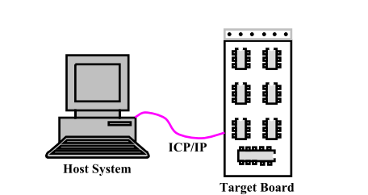
Schematic Representation of a Host-Target System
The host system must have the program development environment, including compilers, editors, library, cross-compilers, debuggers etc.
These are memory demanding applications that
require virtual memory support.
Real-time operating system running on the target board be kept as small and simple as possible.
OS on the target board would lack virtual memory management support, neither does it support any utilities such as compilers, program editors, etc.
The processor on the target board would run the real-time OS

Slide 16
Host-Target System
The real-time program is developed on the host. It is then cross-compiled to generate code for the target processor.
Subsequently, the executable module is downloaded to the target board.
Tasks are executed on the target board and the execution is controlled at the host side using a symbolic cross-debugger.
Once the program works successfully, it is fused on a ROM or flash memory and becomes ready to be deployed in applications.
Commercial examples of host-target real-time operating systems include PSOS, VxWorks,and VRTX

Slide 17
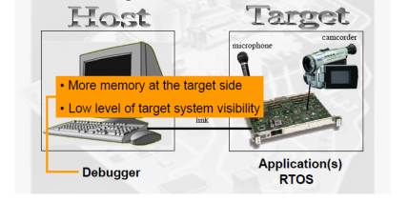

Slide 18
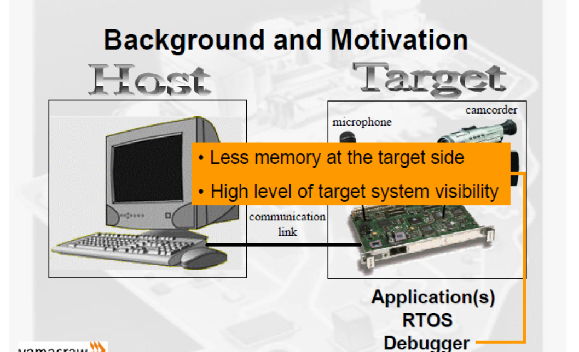

Slide 19

General debugging methods
There are many ways to debug hardware:
ICE
ICD
Simulation
Serial RS232
LCD
LED
Hardware pins
Logic Analyzer

Slide 20
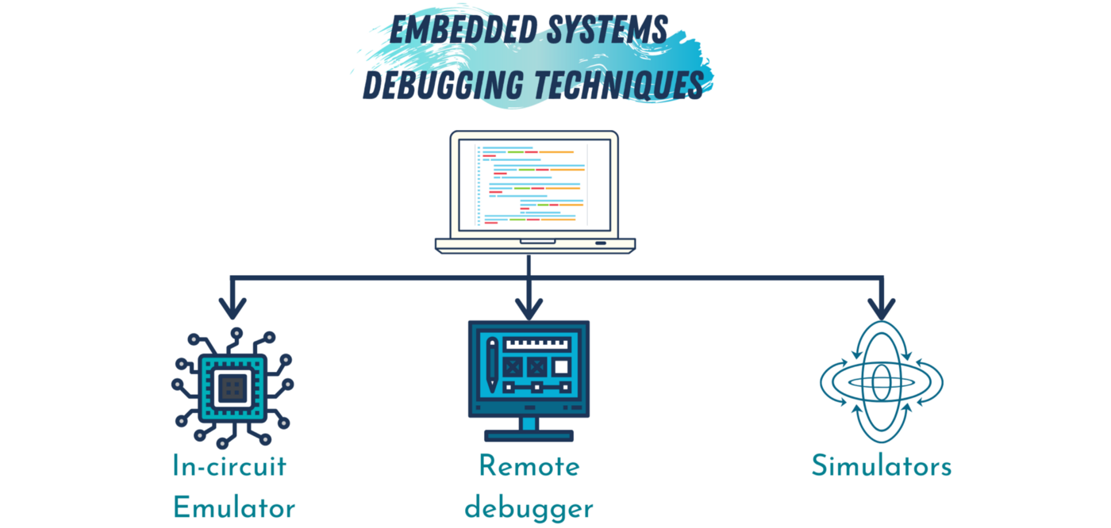
Debugging Tools
Different debugging options.
Simulators
Using remote target processors.
In circuit emulators(ICE)

Slide 21
Debugging with simulators
Simulator is a host-based program that simulates functionality and instruction set of target processor.
The front-end has text or GUI-based windows for source code, register contents, etc.
Simulators are valuable during early stages of development.
Disadvantage of this method is that, it only simulates the processor, and not the peripherals.

Slide 22
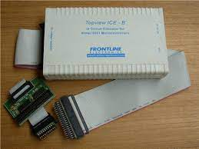
In Circuit Emulator(ICE)
The In Circuit Emulator is the most expensive way to debug the hardware.
It is a special processor that physically takes the place of the normal processor.
This special processor allows software access to the internal operation of the processor
breakpoints can be set on hardware modules

Slide 23
Debugging with(In Circuit Emulator) ICE
In-Circuit Emulator (ICE) takes the place of the target processor.
It contains a copy of target processor, plus RAM, ROM, and its own embedded software.
It allows to examine the state of the processor while the program is running.
It uses the remote debugger for human interface.
It has real time tracing.
It stores the information about each processor cycle which is executed.

Slide 25
(In Circuit Debug) aka (BDM - Background Debug Mode
An in-circuit debugger is a hardware device, connected between a PC and the target microcontroller test system, and is used to debug real-time applications faster and easier.
With in-circuit debugging, a monitor program runs in the microcontroller in the test circuit
The interface allows a Host to manage and query a target.
Allows single step walk through code actually running in the target processor
For ICD the processor has a small amount of built in hardware that can halt the processor when the program reaches a specific address.

Slide 27
(In Circuit Debug) aka (BDM - Background Debug Mode
The software can then read back all the registers and processor state.
Since all processors that support ICD have the ICD hardware built in, the only extra cost is the ICD communication hardware (between the PC and the processor/microcontroller).
Other than ICE or ICD there are several choices for getting debug data out of the microcontroller. Namely RS232, an LCD or a port pin.

Slide 28
It requires a single wire and specialized electronics in the system being debugged.
No special hardware is required in the host; a simple bidirectional I/O pin is sufficient.
The signals used by BDM to communicate data to and from the target are initiated by the host processor. The host negates the transmission line, and then either
Asserts the line sooner, to output a 1, OR later, to output a 0,
Tri-states its output, allowing the target to drive the line.
The host can sense a 1 or 0 as an input value.
At the start of the next bit time, the host negates the transmission line, and the process repeats. Each bit is communicated in this manner.

Slide 29
This capability, implemented in various processors under such names as background debug mode (BDM), JTAG and on-chip in-circuit emulation, puts basic debugging functions on the chip itself.
With a BDM (1 wire interface) or JTAG (standard JTAG) debug port, the microcontroller can be controlled and monitored solely through the stable on-chip debugging services.
This debugging mode runs even when the target system crashes and enables developers to continue investigating the cause of the crash.

Slide 30
In Circuit Debugger (ICD) vs In Circuit Emulator (ICE)
The fundamental difference between and In Circuit Debugger (ICD) and an In Circuit Emulator (ICE) is all about what resources are used to control the debug target. For an ICE the resources are supplied by the emulation hardware. For an ICD the resources come from the program and data space of the debug target. Simply stated: Target code for an ICE is exactly the same as the product code. Target code for an ICD is different from the product code. Many microcontroller have implemented a hybrid of these methods that implement hardware to aid in setting break points and watch points but still need some code and data space to catch these events and report the debug target state to the debug host.

Slide 31
JTAG ( Joint Test Action Group)

Slide 32
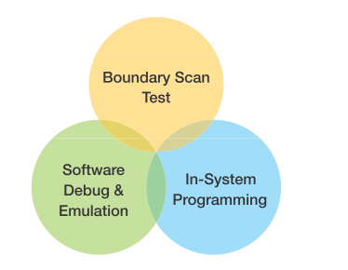
JTAG
Processors often use JTAG to provide access to their debug/emulation functions and all FPGAs and CPLDs use JTAG to provide access to their programming functions.
JTAG is NOT JUST a technology for processor debug/emulation.
JTAG is NOT JUST a technology for programming FPGAs/CPLDs.
The debug and programming tools commonly associated with JTAG only make use of one aspect of the underlying technology –the four-wire JTAG communications protocol.
These four signals, collectively known as the Test Access Port or TAP, are part of IEEE Std. 1149.1.

Slide 33
JTAG emulator
In computing, an emulator is hardware or software that enables one computer system (called the host) to behave like another computer system (called the guest).
An emulator typically enables the host system to run software or use peripheral devices designed for the guest system
JTAG emulators are the inevitable connection between PC software tools and DSP boards during development.
JTAG-based debug provides a "stop-action, close-up view" of what's happening on the board and inside the DSP(s).

Slide 34
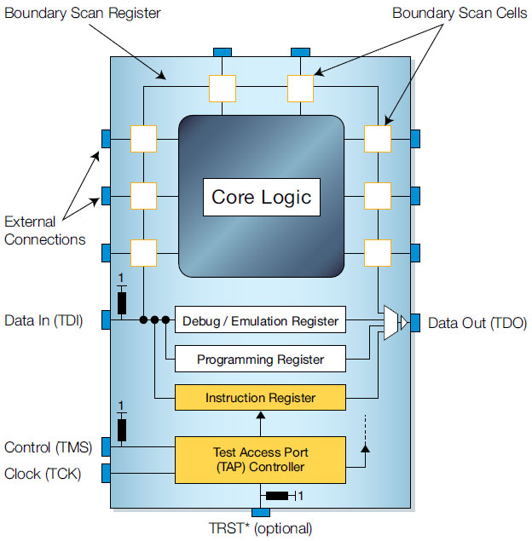
JTAG Emulators

Slide 35
JTAG in embedded system
Joint Test Action Group (JTAG) is the common name used for a debugging, programming, and testing interface typically found on microcontrollers, ASICs, and FPGAs.
JTAG is a common hardware interface that provides a way to communicate directly with the chips on a board
This standard defines the Test Access Port (TAP) controller logic used in processors with JTAG interfaces
JTAG allows device programmer hardware to transfer data into internal non-volatile device memory (e.g. CPLDs)

Slide 36
The TAP signals shown in the illustration are used to control the boundary scan device.
• Test Data In (TDI): The serial input for test data and instruction bits.
• Test Data Out (TDO): The serial output for test data.
• Test Clock (TCK): An independent clock used to drive the device.
• Test Mode Select (TMS): This provides the logic levels needed to change the TAP Controller from state to state.
• Test Reset (TRST) Optional: This optional input provides asynchronous initialization of the TAP Controller, which in turn causes asynchronous initialization of other test logic included in the design.
Boundary scan devices have a dedicated port, called the Test Access Port (TAP), that routes input signals to a controller, called the TAP Controller, and the register cells.
The TAP Controller is a 16-state machine that controls the Boundary Register.

Slide 37
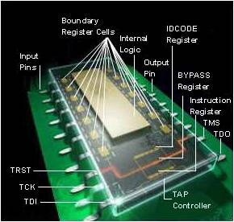
Boundary scan
Boundary scan is a test technique that involves devices designed with shift registers placed between each device pin and the internal logic as shown in Figure
Each shift register is called a Boundary scan cell.
These boundary scan cells allow the user to control and observe what happens at each input and output pin.
When these cells are connected together, they form a data register chain, called the Boundary Register.
The individual bits, or cells, of this register are at the boundary of the device, between its functional core and the pins by which it is connected to a board – very often JTAG testing is referred to as boundary scan

Slide 38

An Instruction Register decodes instruction bits that allow the device to perform various functions. • A Bypass Register provides a one-bit path that minimizes the distance between the scan input and the scan output. • An Identification Register, called the IDCODE Register, identifies the device and manufacturer. • Other designer-specified data registers typically perform internal test functions.

Slide 39
Boundary scan
Boundary scan cells can operate in two modes.
In their functional mode they have no effect on the operation of the device – this is the mode in which they operate when the board is running normally.
In their test mode they disconnect the functional core of the device from the pins.
Disconnecting the control of the pins from the functionality of the enabled device makes boundary scan test development significantly easier than traditional functional test as no device configuration or booting is required to use the pins

Slide 40
JTAG and SWD
Serial Wire Debug (SWD) is an ARM specific protocol designed specifically for micro debugging.
JTAG (Joint Test Action Group) was designed largely for chip and board testing.
It is used for boundary scans, checking faults in chips/boards in production.
Debugging and flashing micros was an evolution in its application over time

Slide 41
ARM provides a built-in debugging port called the DAP or the debug access port.
This allows users to control many aspects of the CPU.
This port also provides support for multiple debugging interface standards including JTAG and Serial Wire Debug or SWD.
Depending on the debugger, there can be multitude of supporting features.
ability to set breakpoints and watch points
inspect memory
read and write to the peripheral registers
inspect assembly and even monitor
stack trace.

